Slide 1
Distributed Systems Design COMP 6231
Coordination – Part I
Lecture 07
Essam Mansour

Slide 2
Today…
Today’s Session
Synchronization
Coordinated Universal Time (UTC)
Tracking Time on a Computer
Clock Synchronization: Cristian’s Algorithm, Berkeley Algorithm and Network Time Protocol (NTP)

Slide 3
Synchronization
Until now, we have looked at:
How entities can be organized and communicate with each other
How entities are named and identified
In addition to the above requirements, entities in DSs often have to cooperate and synchronize to solve a given problem correctly
E.g., In a distributed file system, processes have to synchronize and cooperate such that two processes are not allowed to write to the same part of a file

Slide 4
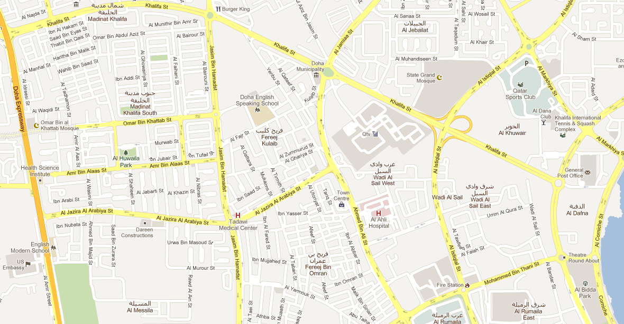

Need for Synchronization – Example 1
Vehicle tracking in a City Surveillance System using a Distributed Sensor Network of Cameras
Objective: To keep track of suspicious vehicles
Camera Sensor Nodes are deployed over the city
Each Camera Sensor that detects a vehicle reports the time to a central server
Server tracks the movement of the suspicious vehicle
1:12 PM:
Car spotted
1:08 PM:
Car spotted
1:05 PM:
Car spotted
1:16 PM:
Car spotted
If the sensor nodes do not have a consistent version of the time, the vehicle cannot be reliably tracked
1:15 PM:
Car spotted
1:25 PM:
Car spotted
3:00 PM:
Car spotted
1:00 PM:
Car spotted
1:17 PM:
Car spotted
1:18 PM:
Car spotted

Slide 5
Need for Synchronization – Example 2
Writing a file in a Distributed File System
Client A
Write data1 to file abc.txt at offset 0
Server
Client C
Distributed
File
abc.txt
Write data3 to file abc.txt at offset 1
Client B
Write data2 to file abc.txt at offset 1
If the distributed clients do not synchronize their write operations to the distributed file, then the data in the file can be corrupted

Slide 6
A Broad Taxonomy of Synchronization
Reason for synchronization and cooperation
Examples
Requirement for entities
Topics we will study
Entities have to agree on ordering of events
Entities have to share common resources
E.g., Vehicle tracking in a Camera Sensor Network; Financial transactions in Distributed E-commerce Systems
E.g., Reading and writing in a Distributed File System
Entities should have a common understanding of time across different computers
Entities should coordinate and agree on when and how to access resources
Time Synchronization
Mutual Exclusion

Slide 7
Overview
Today’s lecture
Time Synchronization
Physical Clock Synchronization (or, simply, Clock Synchronization)
Here, actual time on computers are synchronized
Logical Clock Synchronization
Computers are synchronized based on relative ordering of events
Mutual Exclusion
How to coordinate between processes that access the same resource?
Election Algorithms
Here, a group of entities elect one entity as the coordinator for solving a problem
Next two lectures

Slide 8
Overview
Time Synchronization
Clock Synchronization
Logical Clock Synchronization
Mutual Exclusion
Election Algorithms

Slide 9
Clock Synchronization
Clock synchronization is a mechanism to synchronize the time of all the computers in a DS
We will study:
Coordinated Universal Time
Tracking Time on a Computer
Clock Synchronization Algorithms
Cristian’s Algorithm
Berkeley Algorithm
Network Time Protocol

Slide 10
Clock Synchronization
Coordinated Universal Time
Tracking Time on a Computer
Clock Synchronization Algorithms
Cristian’s Algorithm
Berkeley Algorithm
Network Time Protocol

Slide 11
Universal Coordinated Time (UTC)
All the computers are generally synchronized to a standard time called Universal Coordinated Time (UTC)
UTC is the primary time standard by which the world regulates clocks and time
UTC is broadcasted via the satellites
UTC broadcasting service provides an accuracy of 0.5 msec
Computer servers and online services with UTC receivers can be synchronized by satellite broadcasts
Many popular synchronization protocols in distributed systems use UTC as a reference time to synchronize clocks of computers

Slide 12
Clock Synchronization
Coordinated Universal Time
Tracking Time on a Computer
Clock Synchronization Algorithms
Cristian’s Algorithm
Berkeley Algorithm
Network Time Protocol

Slide 13
Tracking Time on a Computer
How does a computer keep track of its time?
Each computer has a hardware timer
The timer causes an interrupt ‘H’ times a second
The interrupt handler adds 1 to its Software Clock (C)
Issues with clocks on a computer
In practice, the hardware timer is imprecise
It does not interrupt ‘H’ times a second due to material imperfections of the hardware and temperature variations
The computer counts the time slower or faster than actual time
Loosely speaking, Clock Skew is the skew between:
the computer clock and the actual time (e.g., UTC)

Slide 14

Clock Drift
When the UTC time is t, let the clock on the computer have a time C(t)
Three types of clocks are possible
Perfect clock:
The timer ticks ‘H’ interrupts a second
dC/dt = 1
Fast clock:
The timer ticks more than ‘H’ interrupts a second
dC/dt > 1
Slow clock:
The timer ticks less than ‘H’ interrupts a second
dC/dt < 1
dC/dt > 1
dC/dt = 1
15
Perfect clock
10
Fast Clock
Clock time, C_{p}(t)
Slow Clock
7
dC/dt < 1
0
10
UTC, t

Slide 15
Clock Drift (cont’d)
Frequency of the clock is defined as the ratio of the number of seconds counted by the software clock for every UTC second
Frequency = dC/dt
Skew of the clock is defined as the extent to which the frequency differs from that of a perfect clock
Skew = dC/dt – 1
Hence,
dC/dt > 1
dC/dt = 1
Perfect clock
Fast Clock
Clock time, C_{p}(t)
Slow Clock
dC/dt < 1
UTC, t

Slide 16
Maximum Drift Rate of a Clock
The manufacturer of the timer specifies the upper and the lower bound that the clock skew may fluctuate. This value is known as maximum drift rate (ρ)
How far can two clocks drift apart?
If two clocks are drifting from UTC in the opposite direction, at a time Δt after they were synchronized, they may be as much as 2ρΔt seconds apart
Guaranteeing maximum drift between computers in a DS
If maximum drift permissible in a DS is δ seconds, then clocks of every computer must be resynchronized at least every δ/2ρ seconds
1 – ρ <= dC/dt <= 1 + ρ

Slide 17
Clock Synchronization
Coordinated Universal Time
Tracking Time on a Computer
Clock Synchronization Algorithms
Cristian’s Algorithm
Berkeley Algorithm
Network Time Protocol

Slide 18
Cristian’s Algorithm
Flaviu Cristian (in 1989) provided an algorithm to synchronize networked computers with a time server
The basic idea:
Identify a network time server that has an accurate source for time (e.g., the time server has a UTC receiver)
All the clients contact the network time server for synchronization
However, the network delays incurred when the client contacts the time server results in outdated time
The algorithm estimates the network delays and compensates for it

Slide 19
Cristian’s Algorithm – Approach
Client Cli sends a request to Time Server Ser, time stamped its local clock time T1
Ser will record the time of receipt T2 according to its local clock
dTreq is network delay for request transmission
Time Server Ser
T2
T3
T1
T1, T2, T3
Client Cli
T1
T4
dTreq
dTres
Ser replies to Cli at its local time T3, piggybacking T1 and T2
Cli receives the reply at its local time T4
dTres is the network delay for response transmission
Now Cli has the information T1, T2, T3 and T4
Assuming that the transmission delay from Cli→Ser and Ser→Cli are the same
T2-T1 ≈ T4–T3

Slide 20
Christian’s Algorithm – Synchronizing Client Time
Client C estimates its offset θ relative to Time Server S
θ = T3 + dTres – T4
= T3 + ((T2-T1)+(T4-T3))/2 – T4
= ((T2-T1)+(T3-T4))/2
If θ > 0 or θ < 0, then the client time should be incremented or decremented by θ seconds
T2
T3
S
C
T1
T4
dTreq
dTres
Gradual Time Synchronization at the client
Instead of changing the time drastically by θ seconds, typically the time is gradually synchronized
The software clock is updated at a lesser/greater rate whenever timer interrupts
Note: Setting clock backward (say, if θ < 0)is not allowed in a DS since decrementing a clock at any computer has adverse effects on several applications (e.g., make program)

Slide 21
Cristian’s Algorithm – Discussion
1. Assumption about packet transmission delays
Cristian’s algorithm assumes that the round-trip times for messages exchanged over the network are reasonably short
The algorithm assumes that the delay for the request and response are equal
Will the trend of increasing Internet traffic decrease the accuracy of the algorithm?
Can the algorithm handle delay asymmetry that is prevalent in the Internet?
Can the clients be mobile entities with intermittent connectivity?
Cristian’s algorithm is intended for synchronizing computers within intranets
2. A probabilistic approach for calculating delays
There is no tight bound on the maximum drift between clocks of computers
3. Time server failure or faulty server clock
Faulty clock on the time server leads to inaccurate clocks in the entire DS
Failure of the time server will render synchronization impossible

Slide 22
Clock Synchronization
Coordinated Universal Time
Tracking Time on a Computer
Clock Synchronization Algorithms
Cristian’s Algorithm
Berkeley Algorithm
Network Time Protocol

Slide 23

Berkeley Algorithm
Berkeley algorithm is a distributed approach for time synchronization
Approach:
A time server periodically (approx. once in 4 minutes) sends its time to all the computers and polls them for the time difference
The computers compute the time difference and then reply
The server computes an average time difference for each computer
The server commands all the computers to update their time (by gradual time synchronization)
3:05
3:00
3:00
3:00
Time server
+0:00
+0:05
+0:15
-0:20
-0:10
+0:25
3:05
2:50
3:05
3:25

Slide 24
Berkeley Algorithm – Discussion
1. Assumption about packet transmission delays
Berkeley’s algorithm predicts network delay (similar to Cristian’s algorithm)
Hence, it is effective in intranets, and not accurate in wide-area networks
2. No UTC Receiver is necessary
The clocks in the system synchronize by averaging all the computer’s times
3. Decreases the effect of faulty clocks
Fault-tolerant averaging, where outlier clocks are ignored, can be easily performed in Berkeley Algorithm
4. Time server failures can be masked
If a time server fails, another computer can be elected as a time server

Slide 25
Clock Synchronization
Coordinated Universal Time
Tracking Time on a Computer
Clock Synchronization Algorithms
Cristian’s Algorithm
Berkeley Algorithm
Network Time Protocol

Slide 26
Network Time Protocol (NTP)
NTP defines an architecture for a time service and a protocol to distribute time information over the Internet
In NTP, servers are connected in a logical hierarchy called synchronization subnet
The levels of synchronization subnet is called strata
Stratum 1 servers have most accurate time information (connected to a UTC receiver)
Servers in each stratum act as time servers to the servers in the lower stratum

Slide 27
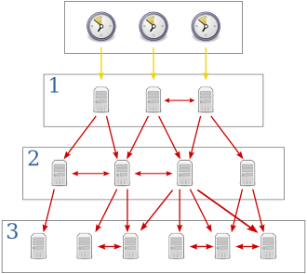
Hierarchical organization of NTP Servers
Stratum 1
This stratum contains the primary servers
that are directly connected to the UTC receivers
Stratum 2
Stratum 2 are secondary servers
that are synchronized directly with primary servers
More accurate time
Stratum 3
Stratum 3 synchronizes with Stratum 2 servers
Last stratum
End user computers synchronize with
the servers in the upper layer stratum

Slide 28
Operation of NTP Protocol
When a time server A contacts time server B for synchronization
If stratum(A) <= stratum(B), then A does not synchronize with B
If stratum(A) > stratum(B), then:
Time server A synchronizes with B
An algorithm similar to Cristian’s algorithm is used to synchronize. However, larger statistical samples are taken before updating the clock
Time server A updates its stratum
stratum(A) = stratum(B) + 1

Slide 29
Discussion of NTP Design
Accurate synchronization to UTC time
Large and variable message delays are tolerated through statistical filtering of timing data from different servers
NTP enables clients across the Internet to be synchronized accurately to the UTC
Scalability
NTP servers are hierarchically organized to speed up synchronization, and to scale to a large number of clients and servers
There are redundant time servers, and redundant paths between the time servers
Reliability and Fault-tolerance
A synchronization subnet can reconfigure as servers become unreachable. For example, if Stratum 1 server fails, then it can become a Stratum 2 secondary server
The architecture provides reliable service that can tolerate lengthy losses of connectivity
Security
NTP protocol uses authentication to check of the timing message originated from the claimed trusted sources

Slide 30
Summary of Clock Synchronization
Physical clocks on computers are not accurate
Clock synchronization algorithms provide mechanisms to synchronize clocks on networked computers in a DS
Computers on a local network use various algorithms for synchronization
Some algorithms (e.g, Cristian’s algorithm) synchronize time by contacting centralized time servers
Some algorithms (e.g., Berkeley algorithm) synchronize in a distributed manner by exchanging the time information on various computers
NTP provides architecture and protocol for time synchronization over wide-area networks such as the Internet

Slide 31
Next Class
Logical Clocks:
Lamport’s Clock
Vector Clocks
Mutual Exclusion
How to coordinate between processes that access the same resource?

